Slide 1
Microsoft Azure Camp
Mohammed Ramees P
Microsoft Certified Trainer

Slide 2
What is Cloud Computing ?
A Cloud computing is the one that allows you to perform virtually any compute or data storage operation by provisioning and scaling the necessary resources on demand on a pay-as-you-go basis.

Slide 3
What you should know ?
Basics of client / server architecture
More clients => more load => more resources to handle it
Qualities of a well architected application:
Availability
Reliability
Maintainability
To manifest these qualities, you need a strategy for expanding compute resources quickly as need arises
Scale up
Scale out
Notes:
Reliability measures the likelihood that any given request that function in the system produce the desired result and it does not produce an error
Availability measures the likelihood that the system is open running and it is ready to handle a request at any given time and it is not gone to be time out.
Maintbilty measures the ease to restore a system back to a state when it breakdown

Slide 4
Scale up and Scale Out
You typically choose to scale up when any single request demands more memory and processing power to complete
Conversely, you typically scale out when any single request requires less memory and processing power to complete

Slide 5
Redundancy
Importance of redundancy, takes different forms at various parts in the system.
Failover
Clustering
Geo-redundancy

Slide 6
Flavors
Infrastructure as a Service (IaaS)
Software as a Service (SaaS)
Platform as a Service (PaaS)

Slide 7
Software as a Service
A pre made application is offered to the user along with all the supporting software.
Its functions remotely as a Web-based service.
You do not have control over nor are you responsible for the hardware on which the service is installed.
A vendor provides everything required to run the application, shielding you from all the underlying components
Usually billed based on usage

Slide 8
Platform as a Service
In PaaS, an operating system, hardware, and network are provided, and the customer installs or develops its own software and applications.
It provides all of the facilities required to support the complete life cycle of building and delivering web applications and services entirely from the Internet.

Slide 9
Infrastructure as a Service
The IaaS model provides just the hardware and network; the customer installs or develops its own operating systems, software and applications.
It is the delivery of technology infrastructure as an on demand scalable service
The lower levels of the stack are managed by the vendor.

Slide 10
Types
Public
Private
Hybrid
Community

Slide 11
Public cloud
Public cloud (off-site and remote) describes cloud computing where resources are dynamically provisioned on an on-demand, self-service basis over the Internet, via web applications/web services, open API, from a third-party provider who bills on a utility computing basis.

Slide 12
Private Cloud
In a private cloud, the cloud infrastructure is operated solely for a specific organization, and is managed by the organization or a third party.
A private cloud environment is often the first step for a corporation prior to adopting a public cloud initiative. Corporations have discovered the benefits of consolidating shared services on virtualized hardware deployed from a primary datacenter to serve local and remote users.

Slide 13
Hybrid Cloud
A hybrid cloud environment consists of some portion of computing resources on-site (on premise) and off-site (public cloud). By integrating public cloud services, users can leverage cloud solutions for specific functions that are too costly to maintain on-premise such as virtual server disaster recovery, backups and test/development environments.

Slide 14
Community Cloud
Community clouds usually exist where a limited number of customers with similar IT requirements share an infrastructure provided by a single supplier. The costs of the services are spread between the customers so this model is better, from an economic point of view, than a single tenant arrangement. Although the cost savings are likely to be greater in a public cloud environment, community cloud users generally benefit from greater security and privacy, which may be important for policy reasons.

Slide 15
Advantages
Access to resources
Mobility
Easily scalable
Data security and storage capacity
Cost savings
Maintenance and support
Environmentally friendly
Free trials

Slide 16
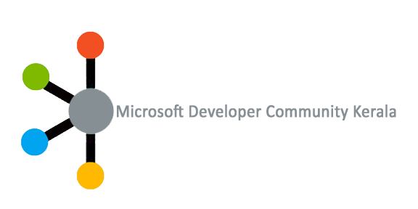
https://www.facebook.com/mdckerala
https://www.facebook.com/groups/mdckerala/

Slide 17
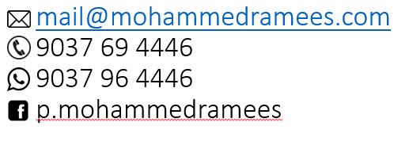
Mohammed Ramees P

Slide 18

© 2012 Microsoft Corporation. All rights reserved. Microsoft, Windows, Windows Vista and other product names are or may be registered trademarks and/or trademarks in the U.S. and/or other countries.
The information herein is for informational purposes only and represents the current view of Microsoft Corporation as of the date of this presentation. Because Microsoft must respond to changing market conditions, it should not be interpreted to be a commitment on the part of Microsoft, and Microsoft cannot guarantee the accuracy of any information provided after the date of this presentation. MICROSOFT MAKES NO WARRANTIES, EXPRESS, IMPLIED OR STATUTORY, AS TO THE INFORMATION IN THIS PRESENTATION.

